Slide 1
Learn those Timetables

Slide 2
0 x tables
The answer is always 0!!!
0 x 5 = 0
0 x 9 = 0
0 x 100 = 0
0 x 559 = 0
Can you think of any yourself?

Slide 3
1 x tables
The answer is always the same!!!
1 x 5 = 5
1 x 100 = 100
1 x 559 = 559
Can you think of any yourself?

Slide 4
2 x tables
Just double the number…
2 x 5 = Double 5 is 10
2 x 8 = Double 8 is 16
2 x 4 = Double 4 is 8
What is 2 x 7?

Slide 5
10 x tables
Just add a zero to the number. (Your making it 10 times bigger!)
10 x 3 = 30
10 x 7 = 70
10 x 5 = 50
10 x 4 = 40
What’s 10 x 9?

Slide 6
5 x tables
Just count up in fives to the number you need.
5 x 4 = 5, 10, 15, 20
5 x 8 = 5, 10, 15, 20, 25, 30, 35, 40
5 x 6 = 5, 10, 15, 20, 25, 30
What is 5 x 7?

Slide 7
9 x tables
Use your hands, there great for the 9’s.
9 x 4 = (Put down your 4th finger)
9 x 8 = (Put down your 8th finger)
9 x 6 = (Put down your 6th finger)
What is 9 x 7?

Slide 8
11 x tables
These are easy, let’s see why…
11 x 3 = 33
11 x 7 = 77
11 x 5 = 55
11 x 4 = 44
What is 11 x 9?

Slide 9
Now for the rest…

Slide 10
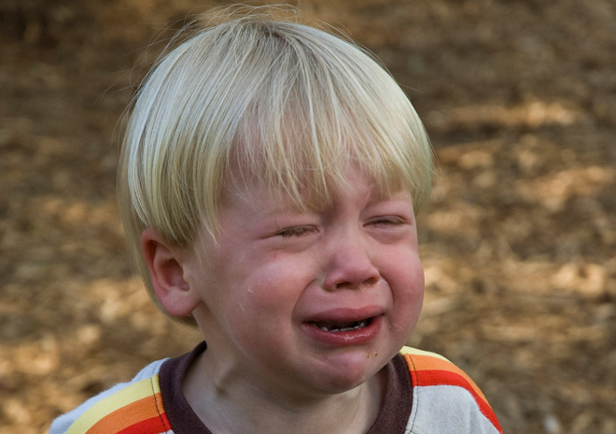
3 x 3 =
(Whine)
9

Slide 11
3 x 4 =
(Two Elf)
12
1
2

Slide 12
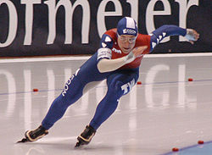
3 x 6 =
(Skating)
18

Slide 13
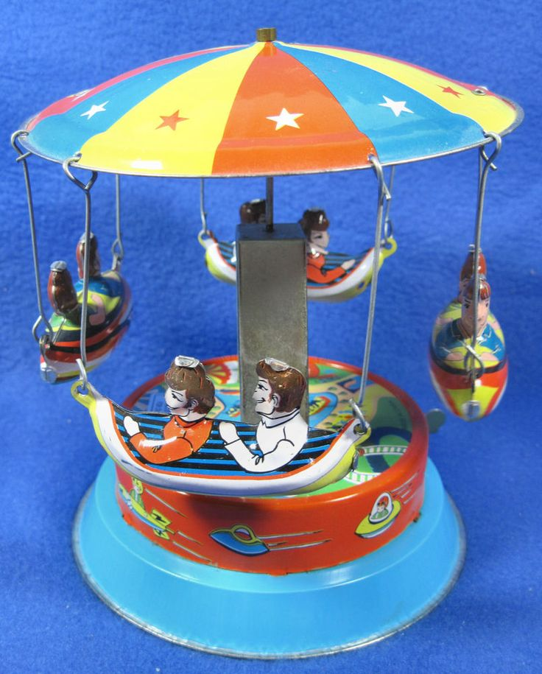
3 x 7 =
(Gently spun)
21

Slide 14
3 x 8 =
(Gently roar)
24

Slide 15
4 x 4 =
(Mixing)
16

Slide 16
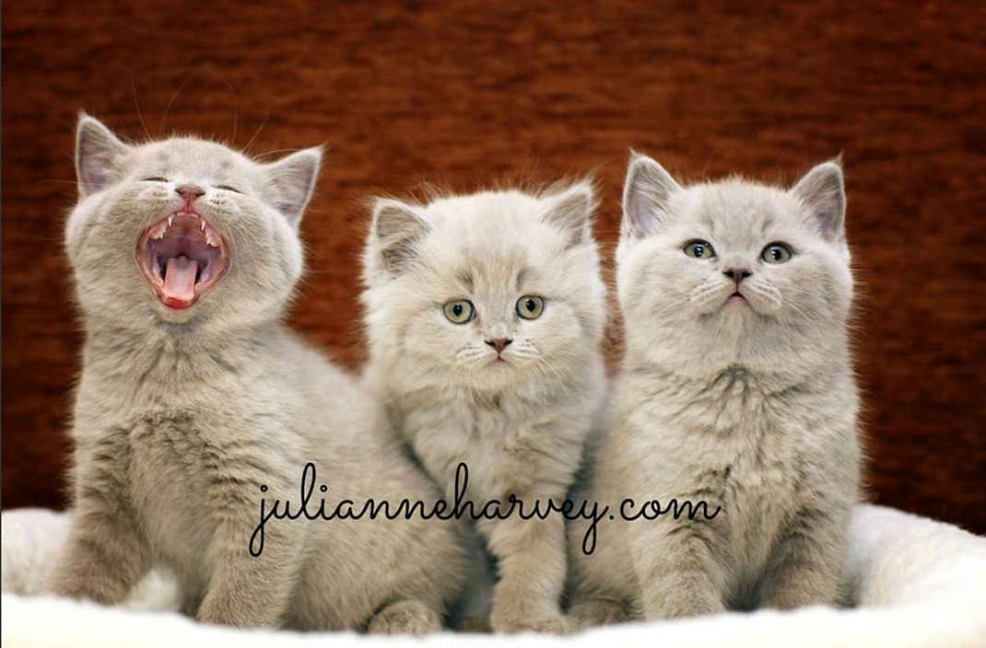
6 x 4 =
(Gently roar)
24

Slide 17
4 x 7 =
(Gently wait)
28

Slide 18
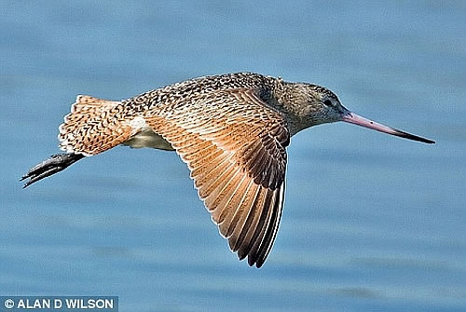
4 x 8 =
(Birdy Flew)
32

Slide 19
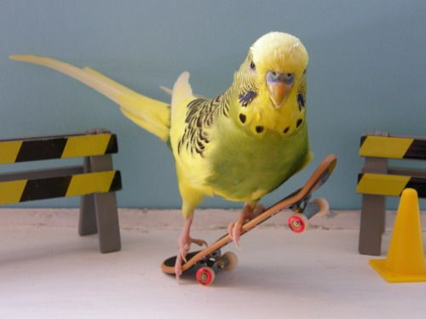
6 x 6 =
(Birdy Tricks)
36

Slide 20
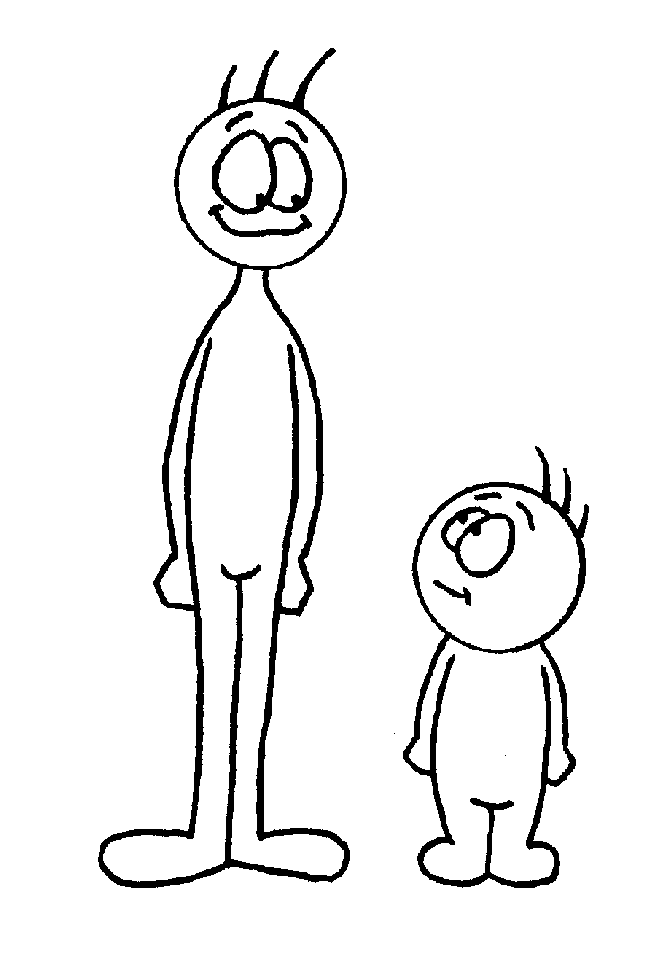
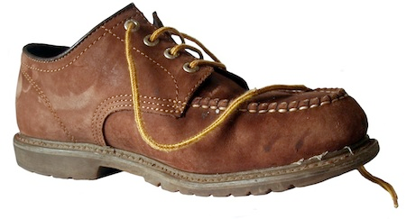
6 x 7 =
(Shorty Shoe)
42

Slide 21
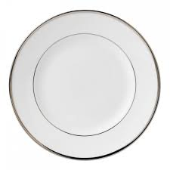
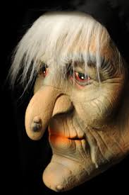
6 x 8 =
(Warty Plate)
48

Slide 22
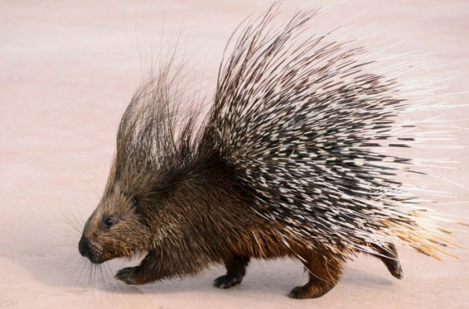
7 x 7 =
(Porcupine)
49

Slide 23
7 x 8 =
(Nifty Tricks)
56

Slide 24
8 x 8 =
64
(Sick on the floor)

